Slide 1
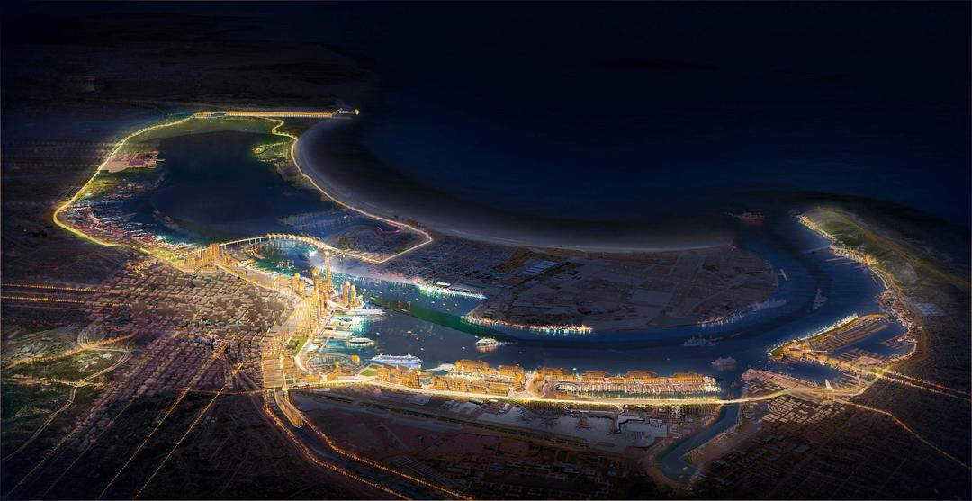


Slide 2
PMPU – Award-Winning Outreach
2019 Award of Excellence, Discussion Draft of the Port Master Plan Update, Public Relations Society of America, San Diego/Imperial Counties
2018 Gold International MarCom Award, PMPU Public Outreach & Engagement (Category: Strategic Communications, Communications/Public Relations – Communications Program) Association of Marketing and Communications Professionals
2018 Award of Excellence - Community Education/Outreach (Port Master Plan Update), American Association of Port Authorities (AAPA)
2018 (CAPIO) Excellence in Public Information and Communications (EPIC) Award
2017 Silver Bernays Award of Excellence for Community Relations
2017 National Environmental Excellence Award, National Association of Environmental Professionals
2016 National Planning Excellence Award for a Planning Advocate (Commissioner Ann Moore), American Planning Association
2016 Silver Bernays Award of Excellence – Public Affairs (Cook and Schmid), Public Relations Society of America
2016 President’s Award (HKS Urban Design Studio/Randy Morton), American Institute of Architects San Diego

Slide 3
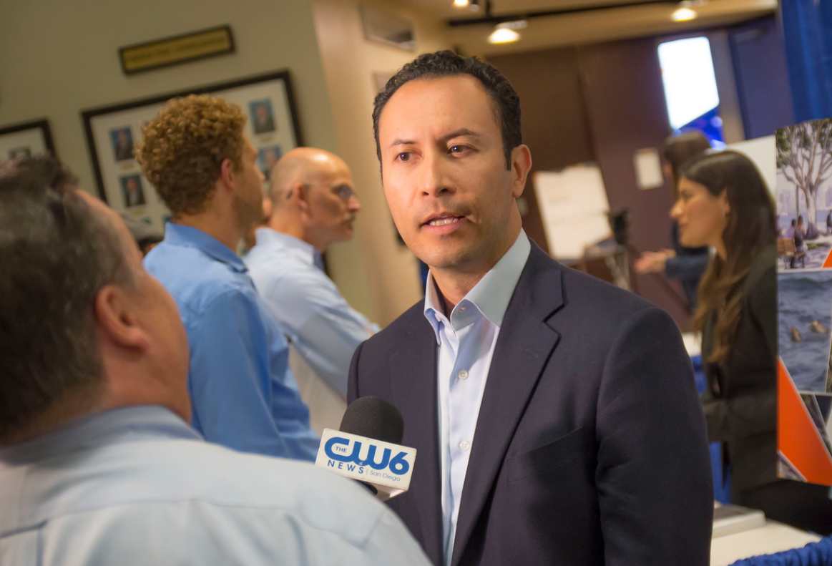
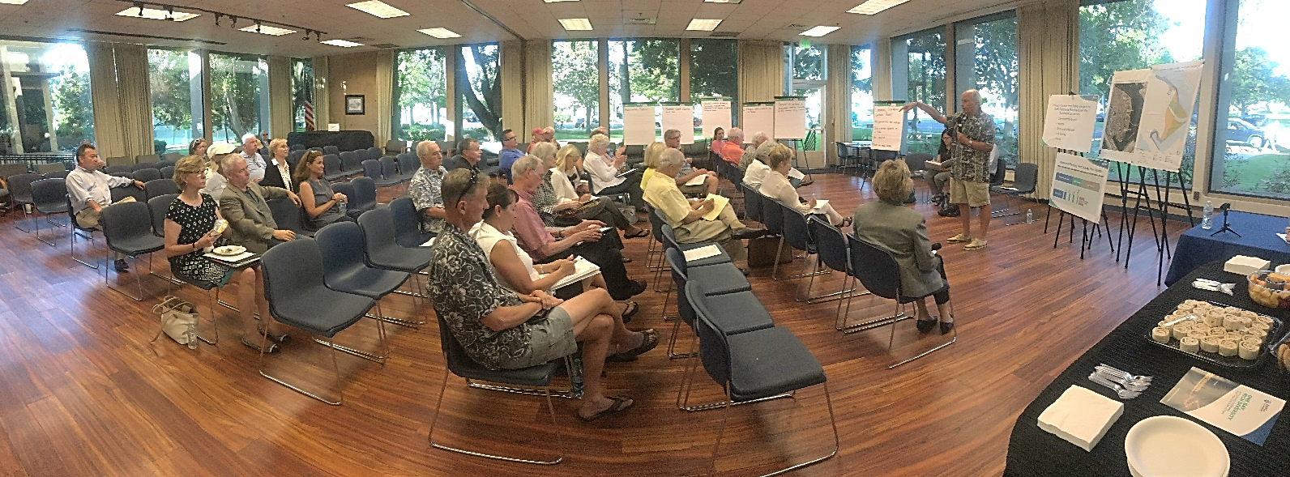
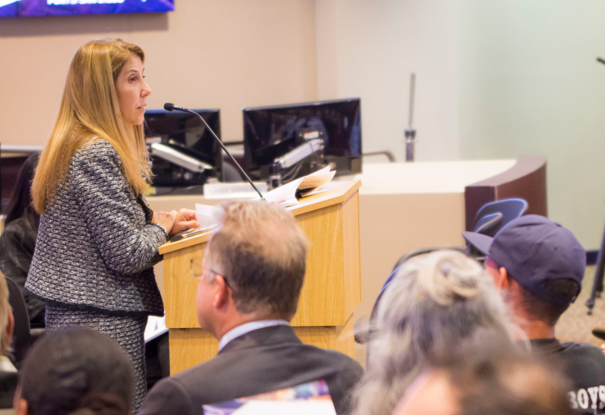
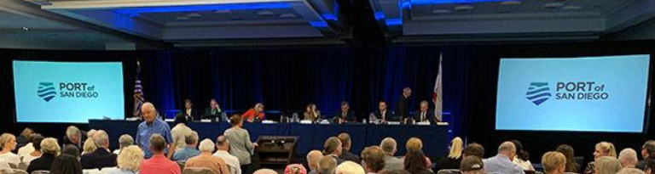

Slide 4
Revised Draft PMPU
Drafting Team
Core Staff:
Jason Giffen
Lesley Nishihira
Rebecca Harrington
Anna Buzaitis
Ashley Wright
Lily Tsukayama
Jenifer Barsell
Brianne Mundy Page
Tom Ortiz
Planning Consultants:
Dennis Larson, Nexus Planning
Christine Babla, Ascent Environmental
Marisa Lundstedt, Summit
Scott Jordan, Civitas
Steve Cook, Chen Ryan
Engagement Team Consultants:
Daniel Reeves, Juniper
Tanya Castaneda, PRM
Derek Danziger, Katz & Associates
Chris Brown, Alchemy

Slide 5
Board of Port Commissioners
Agenda Item No. 1
File No. 2020-0404
PRESENTATION AND DIRECTION TO STAFF ON THE PORT MASTER PLAN UPDATE (PMPU), INCLUDING AN OVERVIEW OF THE COMMENTS RECEIVED ON THE REVISED DRAFT PMPU AND STAFF’S APPROACH TO REVISING THE DOCUMENT
December 7, 2020
PLANNING & GREEN PORT

Slide 6
Revised Draft PMPU Workshop
Staff Presentation
  Background & Public Engagement
  Summary of Comments Received
  Approach to Responding to Comments
  Requested Board Direction
    New Residential Piers
    North Embarcadero Subdistrict
  Next Steps
Public Comment
Board Discussion & Direction to Staff

Slide 7
Port Master Plan Update
Background & Public Engagement

Slide 8
PMPU Public Outreach and Stakeholder Engagement
Vision Statement &
Guiding Principles
Framework Report
Draft PMPU
70
114
51
70
55
30
13
17
2013
2014
2015
2016
2017
2018
2019
2020
5
7
3
2
2
5
10
5
5
3
5
7
Stakeholder Meetings Public Events BPC Meetings and Workshops
421
19
40
37
As of 12/7/2020

Slide 9
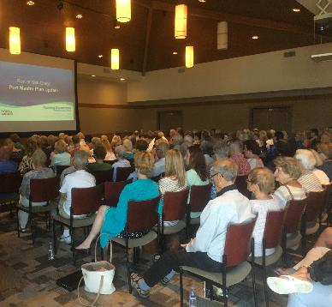
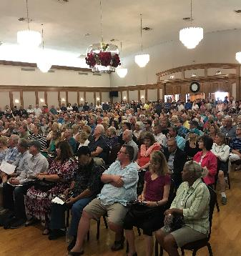
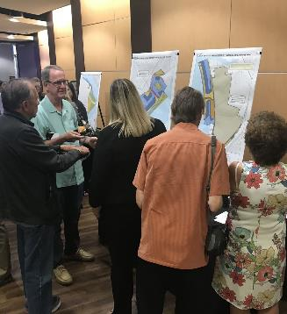
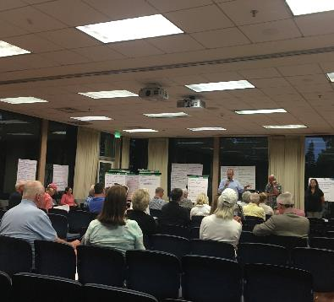
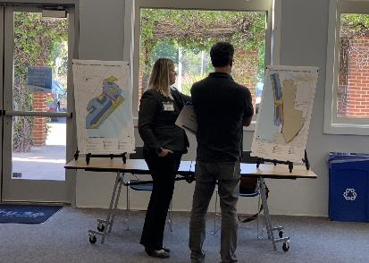
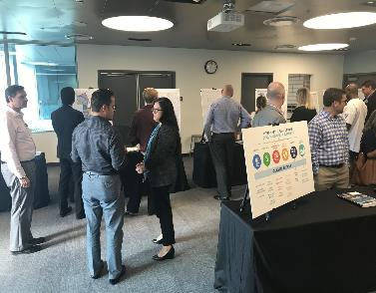
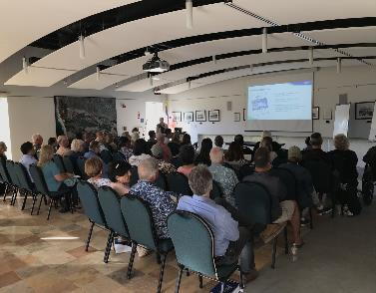
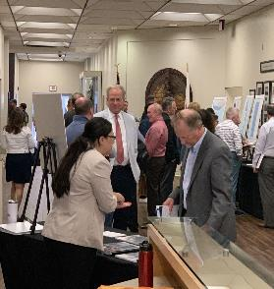
PMPU Community Discussions

Slide 10
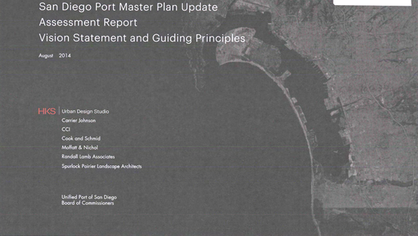
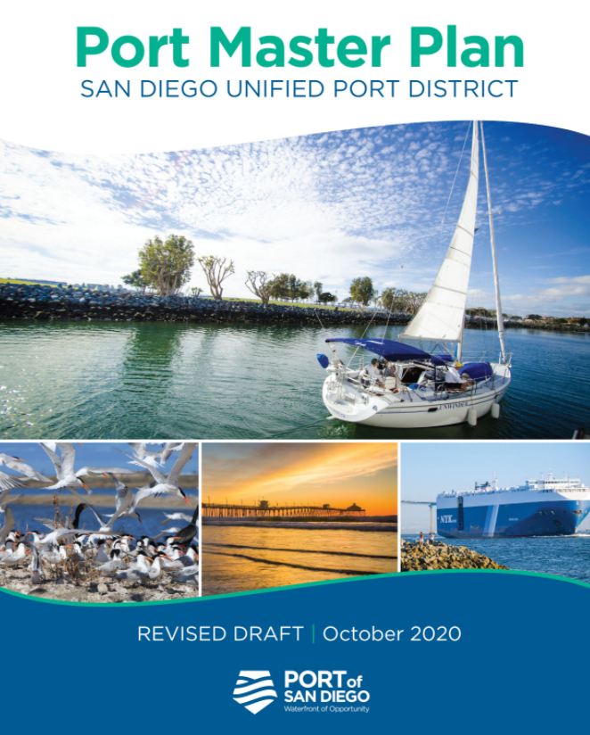
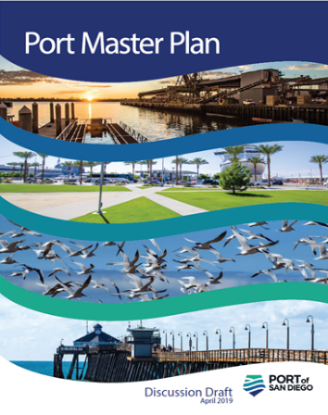
PMPU Milestones
Vision Statement and Guiding Principles
2013-2014
Framework Report
2014-2015
Discussion Draft
2016-2019
Revised Draft PMPU
2019-2020

Slide 11

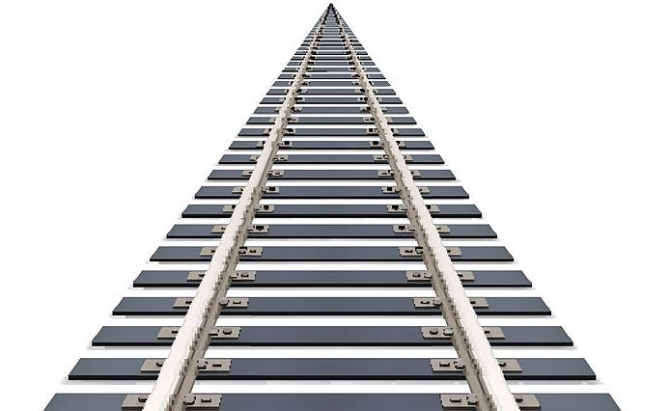

Slide 12



The Port Master Plan is a long-range planning document that focuses on policies not projects
PROJECTS
POLICIES

Slide 13
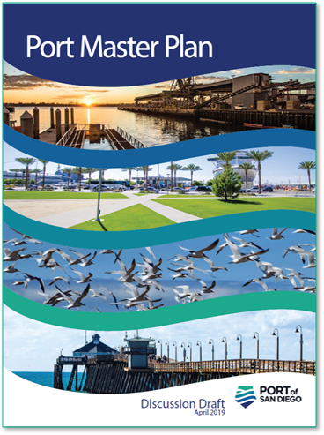
PMPU Discussion Draft
90-Day Review Period:
  April 30 – July 31, 2019
Nearly 4,000 pages of comments received

Slide 14
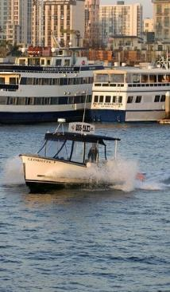
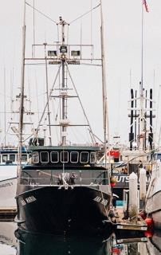
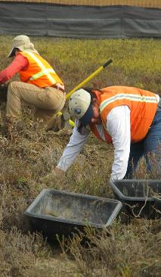
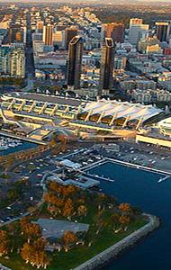
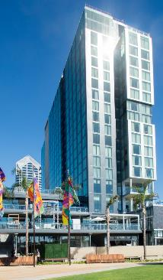
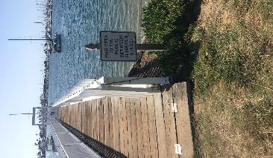
PMPU Workshop - September 16, 2019
Mobility
Maritime
Uses
Environmental Stewardship
Development Intensity
Height
Limits
La Playa
Piers

Slide 15
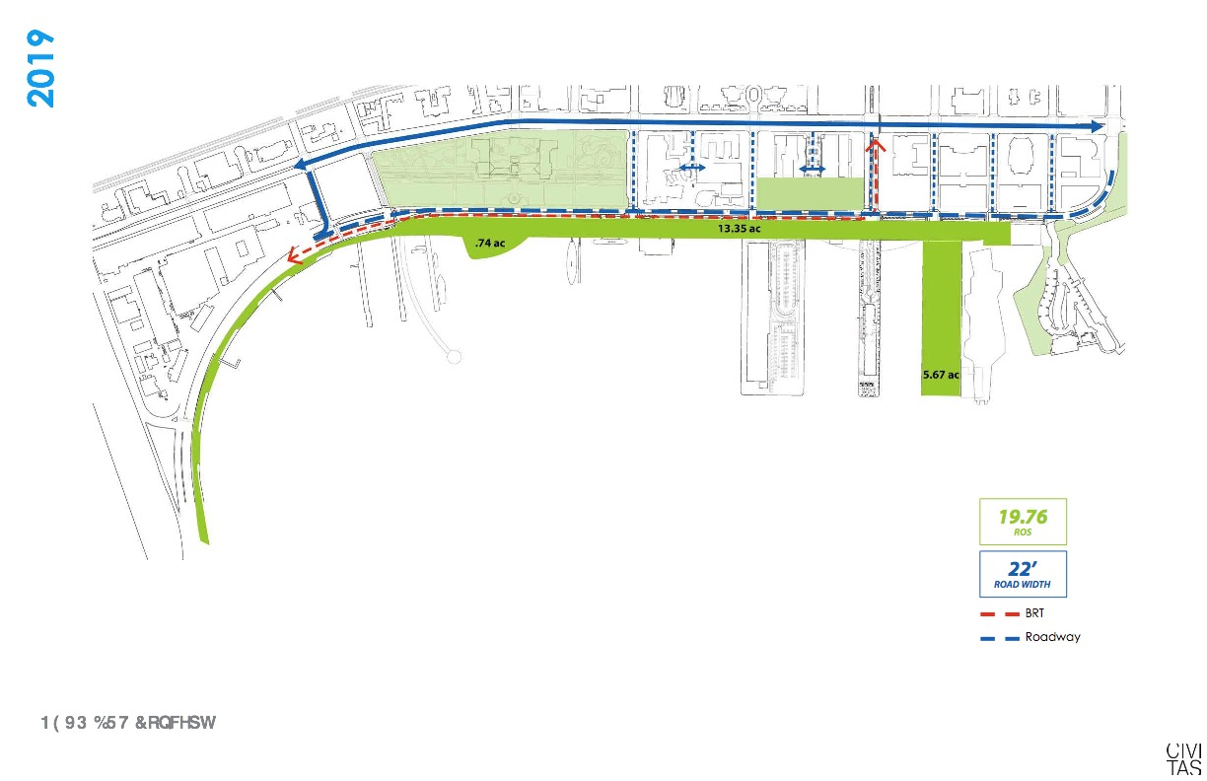
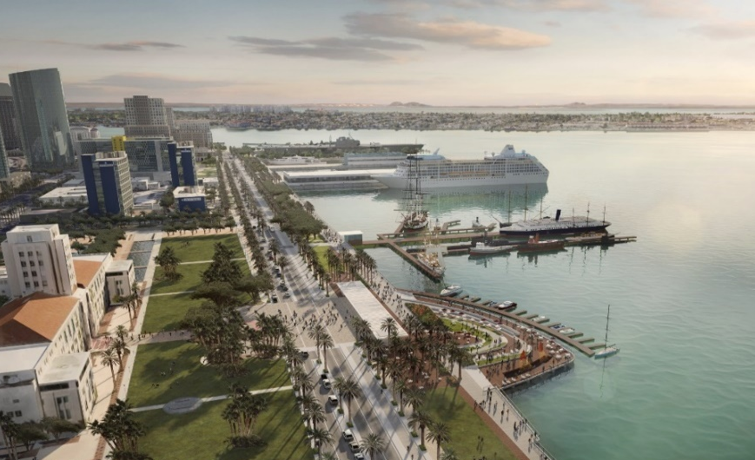
PMPU Workshop – August 4, 2020
Note: Ultimate condition to occur once on-site parking has been relocated to a proximate Mobility Hub
5.7 ac
Graphics are for illustrative purposes only
North Embarcadero Subdistrict

Slide 16
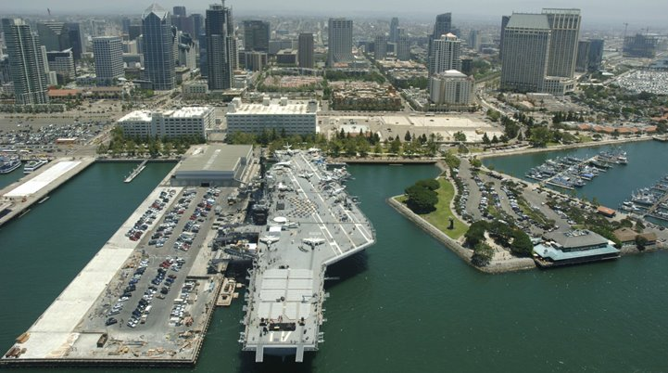
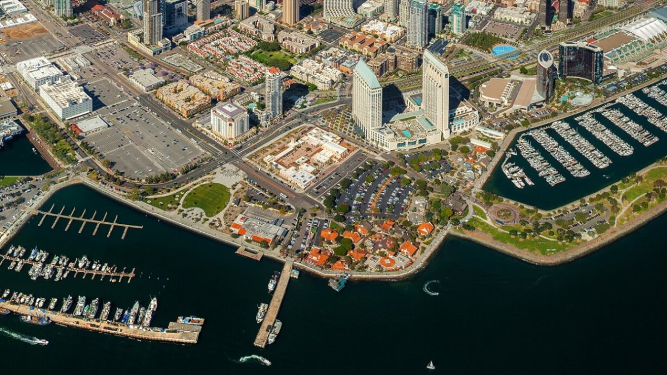
Board Update – October 9, 2020
Navy Pier & Central Embarcadero

Slide 17
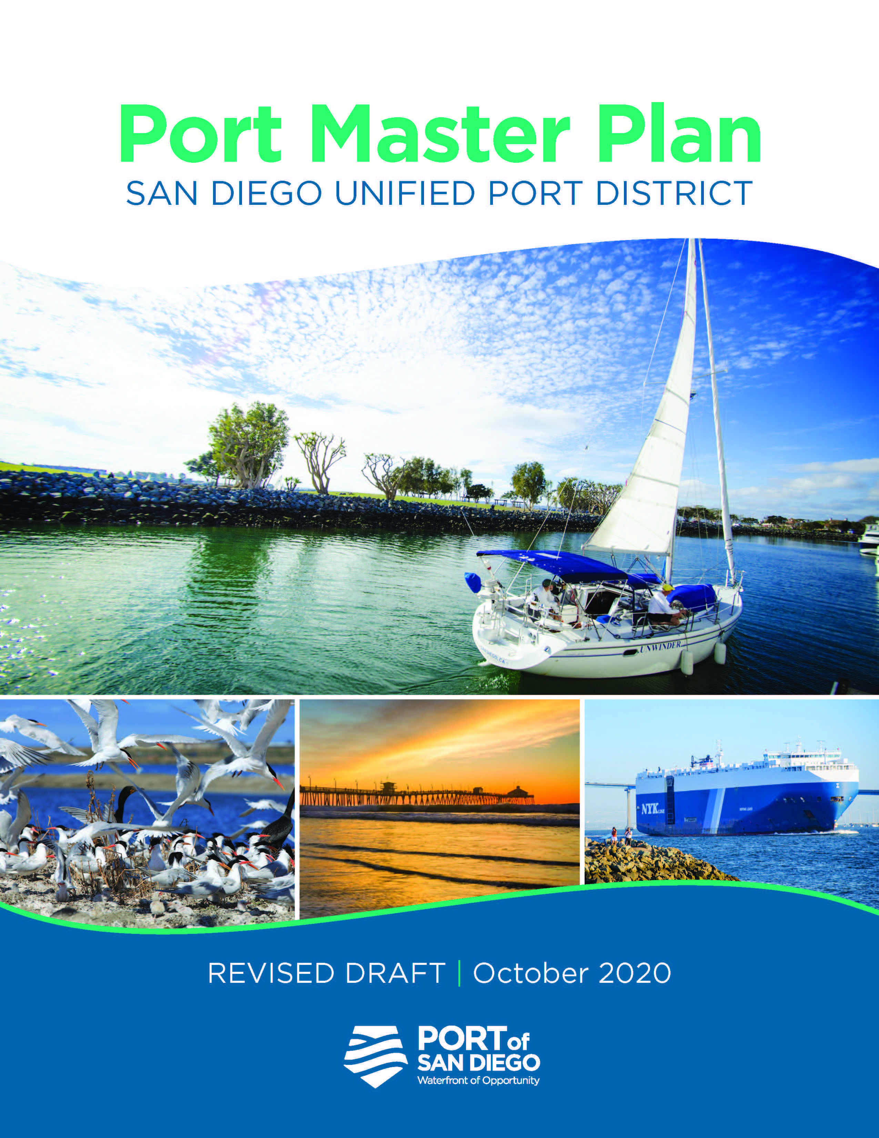
Revised Draft PMPU
Revised Draft PMPU published on October 20, 2020
4-week public review period ended November 17, 2020
Over 400 comments received

Slide 18
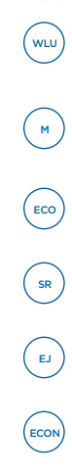
Revised Draft PMPU
Contents
Background
User Guide
Elements
Baywide Development Standards
Planning Districts
Appendices
Water and Land Use
Mobility
Ecology
Safety and Resiliency
Environmental Justice
Economics

Slide 19
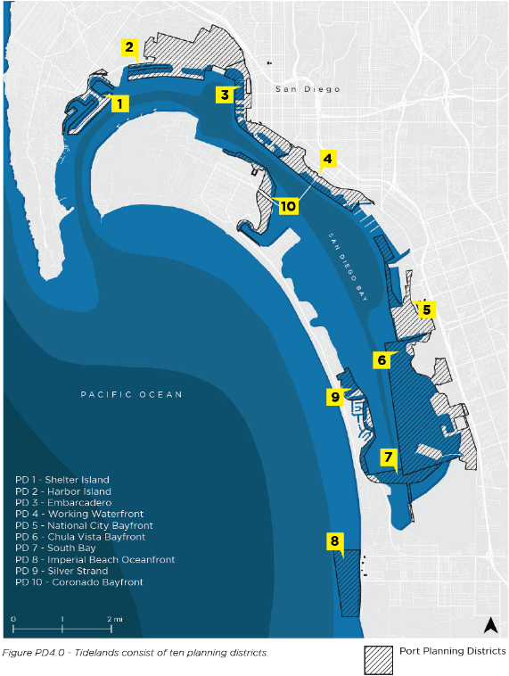
Revised Draft PMPU
Planning Districts
PD1 Shelter Island
PD2 Harbor Island
PD3 Embarcadero
PD4 Working Waterfront
PD5 National City Bayfront*
PD6 Chula Vista Bayfront*
PD7 South Bay (Pond 20 Excluded*)
PD8 Imperial Beach Oceanfront
PD9 Silver Strand
PD10 Coronado Bayfront
* Not included in the PMPU
19

Slide 20
Revised Draft PMPU
Summary of Comments Received

Slide 21
Comments – 406 Total + 58 “I Support”
17

Slide 22
Comments – Support Letters
Several support letters received from organizations, such as:
  Downtown Partnership
  Columbia Community Foundation
  Center City Business District
  Gaslamp Quarter
  East Village Association
  San Diego Regional Chamber of Commerce
  San Diego Downtown Residents Group
Many expressed appreciation for revisions made in response to issues raised during PMPU Discussion Draft review
Several individual commenters were appreciative of reductions in development intensity
58 “clicks” on the “support” button on the PMPU webpage

Slide 23
Comments – Agencies & Organizations
Received 9 comment letters from agencies and 17 comment letters from organizations
Comments focused on Baywide topics as they related to the Elements:
  Safety and Resiliency (sea level rise and GHG emissions)
  Mobility (transit and mobility hubs)
  Water and Land Use (acreages and designations)
  Ecology (habitat preservation and mitigation banking)
  Environmental Justice (reducing air pollution and engaging disadvantaged communities)
  Comments made on Planning Districts 1, 2, 3, 4, 8, 9 and 10 as they pertain to an agency or organization’s mission or management authority

Slide 24
Comments – Businesses & Tenants
12 comment letters received from businesses, including tenants
Focused on Baywide topics and specific Planning Districts from a business or tenant perspective. Examples of topics raised:
  Development Standards
  Working Waterfront Perspectives
  Shelter Island Boat Launch
  Commercial Recreation designation in Grand Caribe Isle
  Hotel rooms in the East Harbor Island and North Coronado

Slide 25
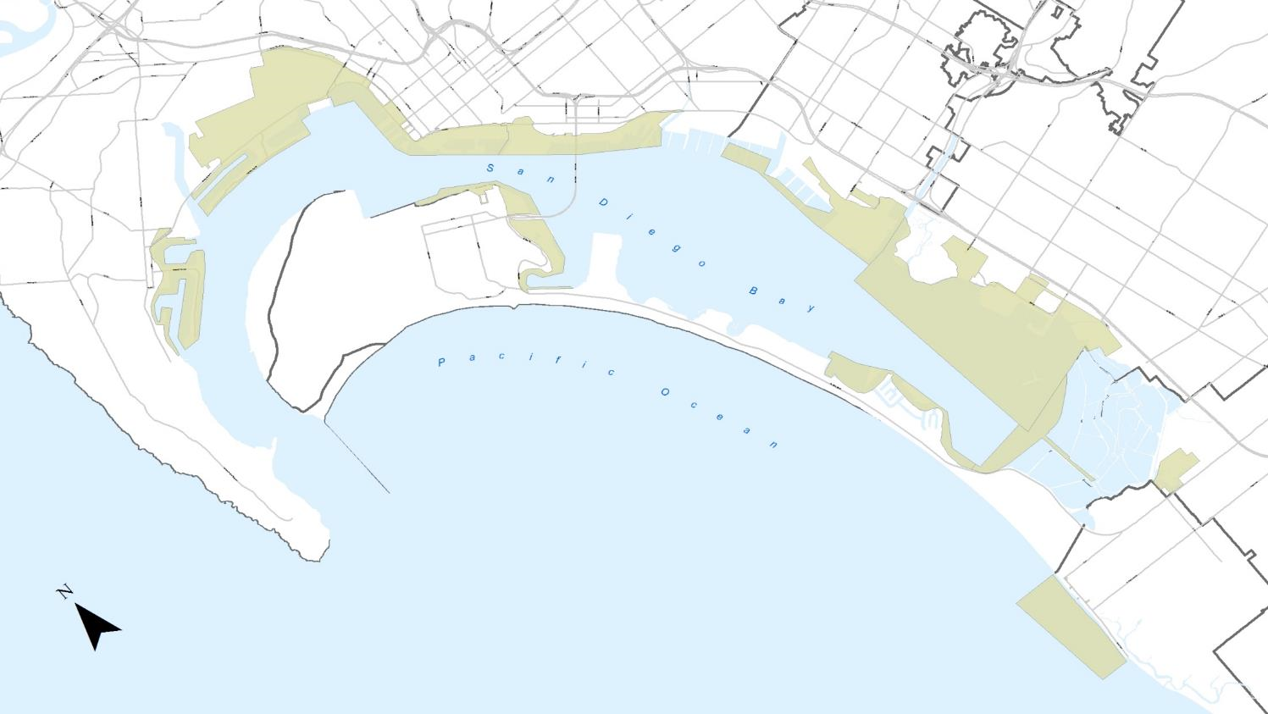
Comments – Individuals & Resident Groups
91
1
Working Waterfront
Harbor
Island
Embarcadero
188
51
National City Bayfront
Coronado Bayfront
Shelter
Island
Chula Vista Bayfront
17
Silver Strand
1
South Bay
7
Baywide
Multiple Planning Districts
Other (not location-specific)
3
8
1
Imperial Beach Oceanfront
25

Slide 26
Comments – Individuals & Resident Groups
368 comment letters received from individuals and resident groups
Comments focused on Planning Districts or Subdistricts from an individual or resident group perspective. Examples of topics raised:
  La Playa Trail in Shelter Island Planning District
  Shelter Island Boat Launch in Shelter Island Planning District
  Promenades at the yacht clubs in Shelter Island Planning District
  Development intensity in the North Embarcadero Subdistrict
  Commercial Recreational v. Recreation Open Space in Grand Caribe Isle
  Ferry Landing in North Coronado Subdistrict

Slide 27
Revised Draft PMPU
Approach to Responding to Comments

Slide 28
Approach to Responding to Comments
Corrections & Clarifications
National City Bayfront & Chula Vista Bayfront Not Included
Clarify Standards for Hotel Rooms & Ancillary Facilities
No Reductions to Parking for Shelter Island Boat Launch
Not Paving the La Playa Trail
No Multi-use Path Conflicts with Diagonal Parking on Shelter Island
Administrative Clean-up for Omissions

Slide 29
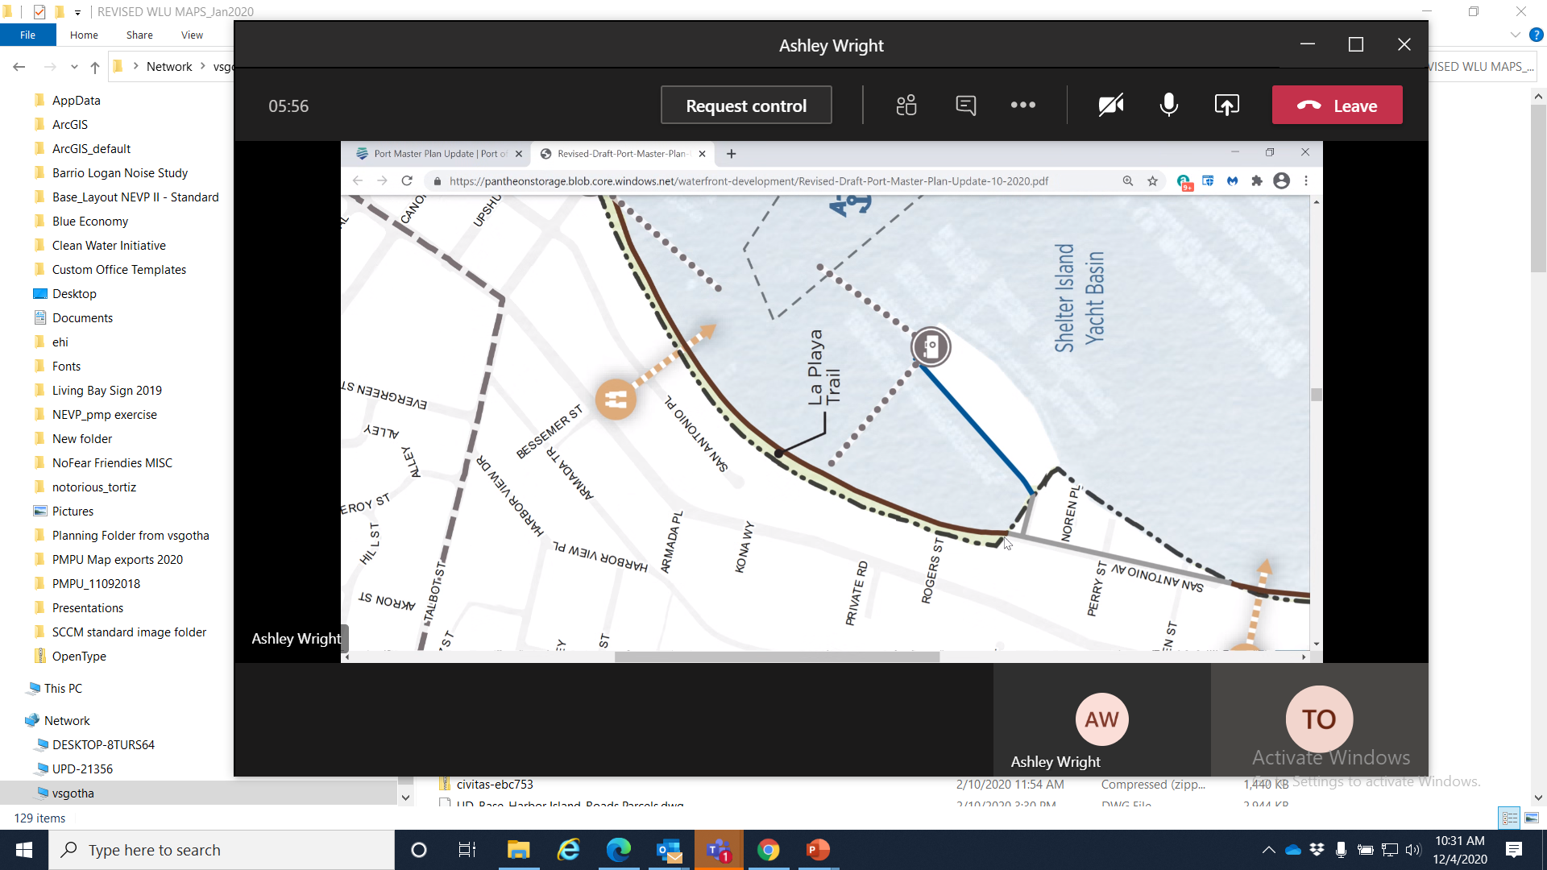
Approach to Responding to Comments
Recommended Revisions To Be Made By Staff
N
Typographical & Terminology Corrections
City of Coronado Requested Revisions
Waterside Promenade at Southwestern Yacht Club
Move Scenic Vista Area
Waterside Promenade to be removed

Slide 30
Approach to Responding to Comments
Policy Issues Still In Progress
Conversion of Navy Pier to a Park
  Pier designated Recreation Open Space in Revised Draft PMPU
  Working collaboratively with Coastal staff and Midway
  Phase I
    Demolition of headhouse and construction of park on portions of the east and west ends of the pier
    Midway to fund with completion within 2 years of PMPU certification
  Phase II
    Ultimately construct 75% of pier as park with 25% of the pier allowed for public parking
    Commitment to timing remains a challenge due to funding constraints
Commercial Fishing: Allowed Secondary Uses
  Conflicting comments received regarding Revised Draft PMPU
  Time needed for staff to work through stakeholder concerns

Slide 31
Approach to Responding to Comments
Environmental Goals & Policy Issues
Comments requested additional environmental goals and policies. Examples topics include:
  Environmental Justice
    Strengthen and add policies related to health impacts on disadvantaged communities
    Add policy on transportation justice to improve access and options for disadvantaged communities
    Add goals for reducing emissions and air pollution, specifically in PD4
  Safety & Resiliency
    Address coordination between agencies
    Identify or prioritize areas in need of coastal adaptation strategies
    Add more specificity for achieving GHG emission reduction goals
    Add policies and context for protecting vulnerable habitats from sea level rise
    Add context and policies for prioritizing and reassessing adaptation strategies
  Ecology
    Conserve and expand existing habitat areas
    Give “environmental stewardship” equal weight when balancing Public Trust
    Increase wetland buffer widths
    Add policies to protect species and habitat from sea level rise and bolster invasive species monitoring
    Add context for mitigation banking ratios and credits
    Clarify and revise the Conservation Open Space & Conservation Intertidal designations to be more protective

Slide 32








│State agencies are actively evolving goals and policies

Slide 33
Environmental Justice in the PMPU
2014
Integrated Planning Guiding Principles
Promote clean air, healthy communities, and environmental justice
Seek to achieve environmental justice which shall be defined as: working to reduce the cumulative health burdens on neighboring communities and ensure fair treatment of people of all races, cultures and incomes in developing, adopting, implementing and enforcing environmental laws, regulations and policies.
(Board accepted, August 2014)
2018
BPC PMPU Workshop
November 1, 2018
Presentation and direction to staff on the Port Master Plan Update – Draft goals and policy concepts for the Environmental Justice Element

Slide 34
Approach to Responding to Comments
Environmental Goals & Policies Issues
Staff Response:
  Related goals and policies have been significantly revised and improved since PMPU Discussion Draft
  Revisions to goals and policies will continue to be refined and informed as environmental analysis proceeds
  Process will benefit from further dialogue with agencies and organizations

Slide 35
Approach to Responding to Comments
Policy Issues Outside the Scope of the PMPU
Comments made addressing more general public policy issues, such as:
  Maintenance and service agreements, including dredging of navigation channels
  Social equity and racial justice
  Participatory budgeting, including funding allocation and capital investment
  Detailed administrative processes for public engagement and hearings

Slide 36
Approach to Responding to Comments
Policy Issues Outside the Scope of the PMPU
Many not within scope of PMPU and more relevant to other policies or programs, such as:
  District’s Budget Process
  Major Maintenance or Capital Improvement Programs
  Municipal Services Agreements
  Port Code
  Board and Administrative Policies
Port Master Plan Update contents guided by Coastal Act requirements, in alignment with the Port Act and Public Trust Doctrine

Slide 37
Revised Draft PMPU
Requested Board Direction

Slide 38
Requested Board Direction
Existing Residential Piers
Residential piers exist in two District areas:
  La Playa in the Shelter Island Planning District
  Coronado Cays in the Silver Strand Planning District

Slide 39
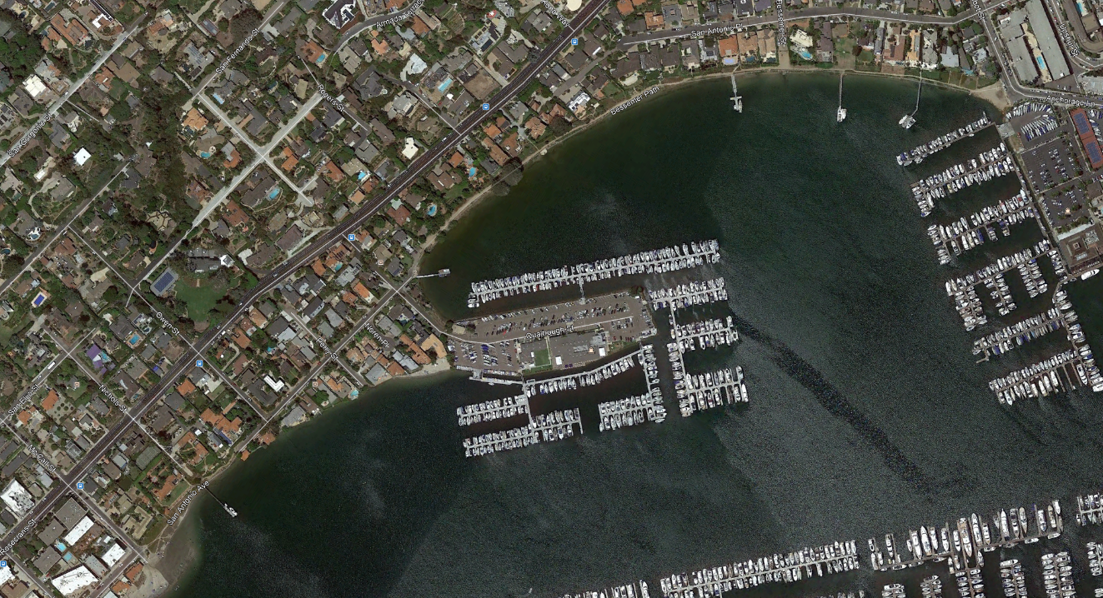
Shelter Island Planning District
Existing La Playa Piers
4. La Playa Yacht Club
3. Donnelley
1. Olson, Alexander, Graham
LA PLAYA TRAIL
Approx 3,870 LF
2. Driscoll
Shelter Island Yacht Basin
5. Arrington/Daly
N

Slide 40
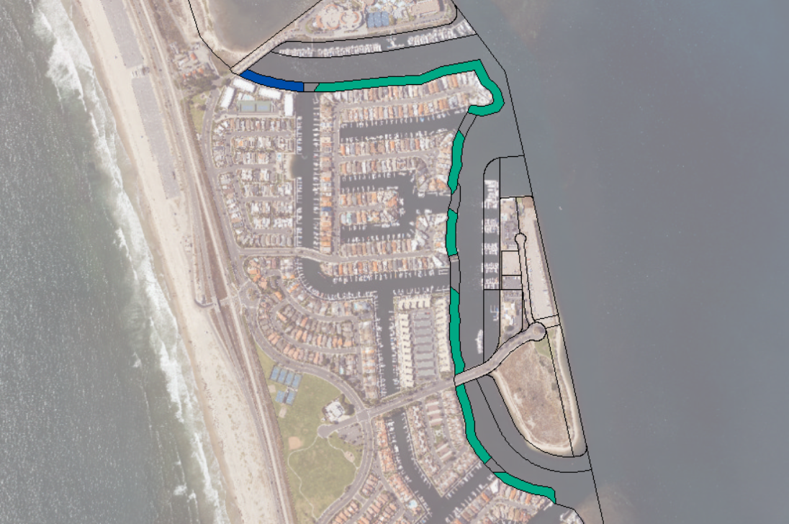
Silver Strand Planning District
Existing Coronado Cays Residential Piers
Montego Bay Marina Limited
CC Wharfage, Inc.
N

Slide 41
Requested Board Direction
New Residential Piers
Revised Draft PMPU included the following:
  Baywide Policy (WLU Policy 4.1.8): “No new private or quasi-private piers, gangways, or docks associated or connected to residential uses shall be permitted on Tidelands.”
  Shelter Island Standard (PD1.3): “No new quasi-public/quasi-private piers associated with residential properties, or for residential use, shall be allowed.”
  Silver Strand Standards (PD9.5 & PD9.15): “Residential piers and docks adjacent to off-Tidelands residences in the Coronado Cays may be repaired or replaced in kind provided changes in configuration have no net increase in square footage of occupied surface area coverage or San Diego Bay water and/or fill in the Bay floor.”

Slide 42
Requested Board Direction
New Residential Piers
Comments received on the Revised Draft PMPU request deletion of policies and standards prohibiting new piers in both Shelter Island and Silver Strand
Pursuant to the California Coastal Act (Act):
  Piers in both areas are subject to Chapter 3 of Act
  Public recreational piers are allowed if they provide public access and recreational opportunities, and boating facilities are also allowed, but only when:
    a less environmentally damaging alternative does not exist, and
    feasible mitigation measures have been provided
  All other Chapter 3 Public Access policies apply

Slide 43
Requested Board Direction
New Residential Piers
Staff requests Board policy direction on whether to prohibit new residential piers or to provide alternative direction
Possible options include:
  Retain proposed Baywide policy and Planning District standards
  Modify Baywide policy and Planning District standards to allow new residential piers only when public access on shoreline is feasible and connections provided
  Delete Baywide policy and create different standards for each Planning District

Slide 44
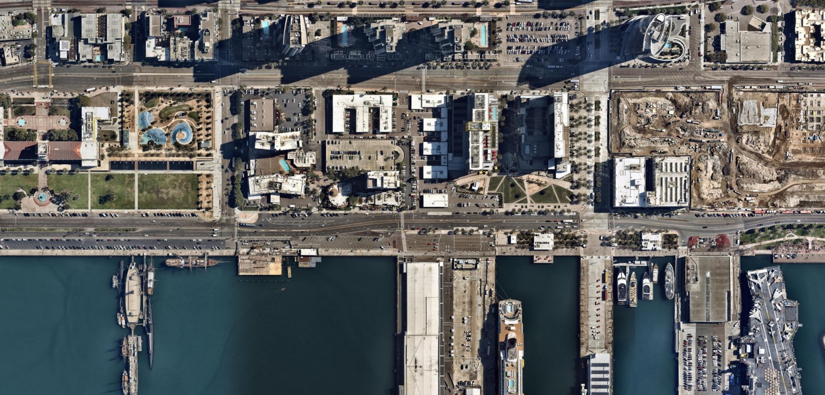
Requested Board Direction
North Embarcadero Subdistrict
Pacific Highway
Ash Street
A Street
B Street
Broadway
Harbor Drive
N
44

Slide 45
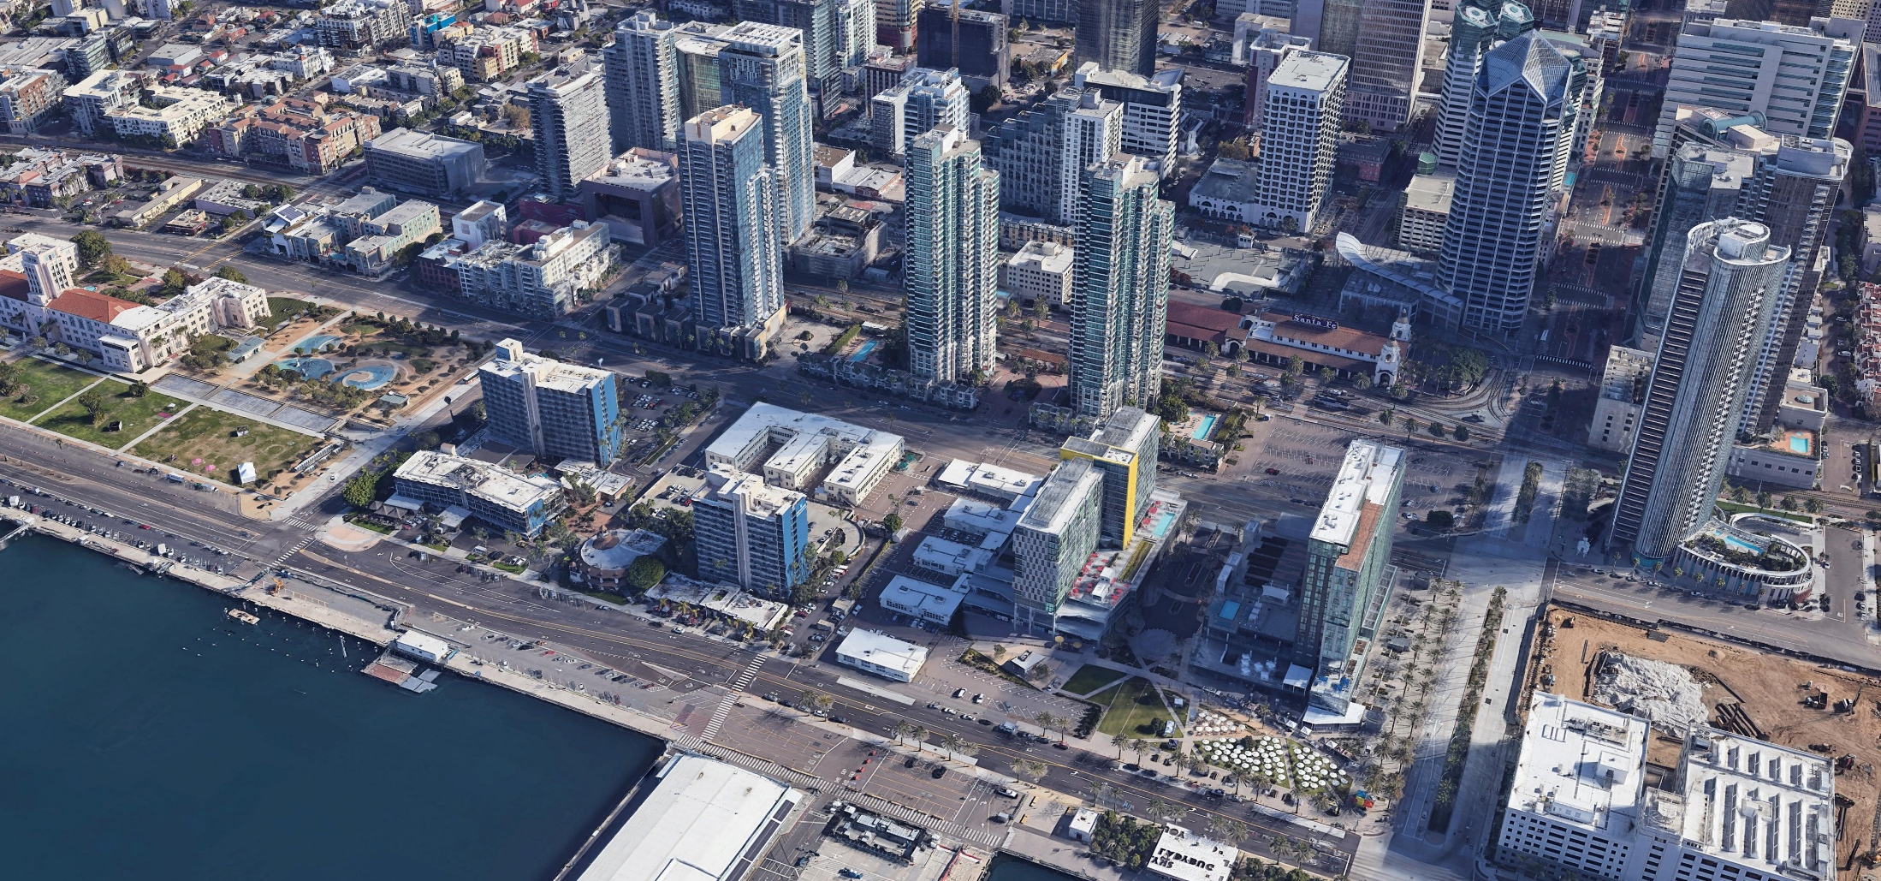
North Embarcadero Subdistrict
Existing Conditions – Building Height
Insert birdseye aerial
Existing Residential – 450’
Lane Field – 185’ (north) & 210’ (south)
Wyndham – 170’ & 60’
45

Slide 46
North Embarcadero Subdistrict
Existing Conditions – Hotel Rooms
Insert birdseye aerial
Lane Field – 800 hotel rooms
Wyndham – 600 hotel rooms
46

Slide 47
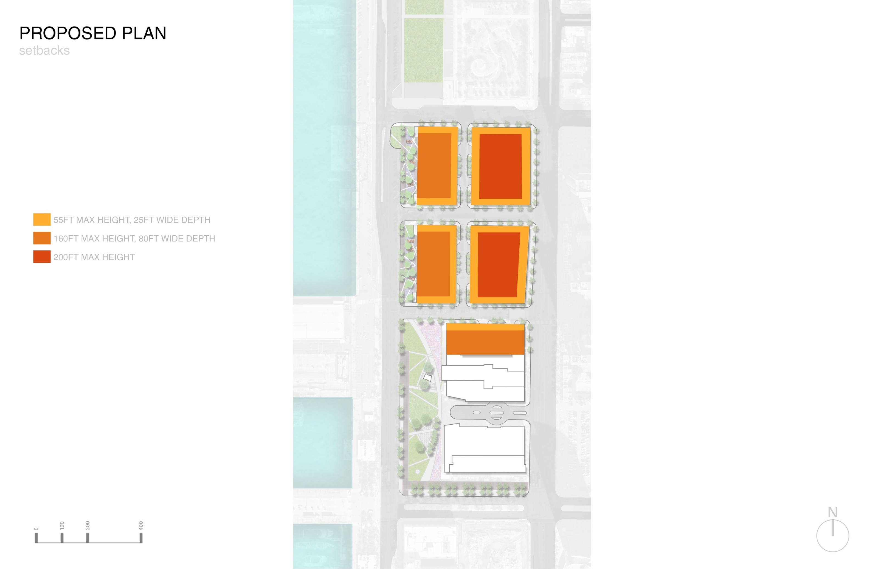

North Embarcadero Subdistrict
PMPU Discussion Draft
PACIFIC HIGHWAY
2,000 Rooms Total
Buildings up to 450’
N
HARBOR DRIVE
Note: Building quantities and locations are conceptual
MATCH ADJACENT (UP TO 450’)

Slide 48
North Embarcadero Subdistrict
Revised Draft PMPU
PACIFIC HIGHWAY
1,550 RoomsTotal
Buildings up to 160’- 200’
N
HARBOR DRIVE
40FT
Note: Building quantities and locations are conceptual
OPTIONAL NORTH-SOUTH LINKAGE

Slide 49
Requested Board Direction
North Embarcadero Subdistrict
Revised Draft PMPU comments from Individuals and Resident Groups included:
  Questions about the relationship of the PMPU and the North Embarcadero Visionary Plan
  Requests to reduce building heights to preserve views from private residences
  Requests to prohibit parking structures
Revised Draft PMPU comments from the City of San Diego included:
  Suggestions to match Downtown Community Plan and Centre City Planned Development Ordinance
  Height limits could be reduced while maintaining development capacity
  Reconsider tower separation requirements, setbacks, stepbacks and right-of-way widths for A and B Streets

Slide 50
Requested Board Direction
North Embarcadero Subdistrict
Clarification on North Embarcadero Alliance Visionary Plan and North Embarcadero Visionary Plan Joint Powers Authority
  JPA is a legal entity, separate and distinct from the District
  JPA purpose is to fund and design phased infrastructure improvements in North Embarcadero
  No requirement to present PMPU to the JPA
  No requirement to pause PMPU process to enable JPA to meet and consider the PMPU

Slide 51
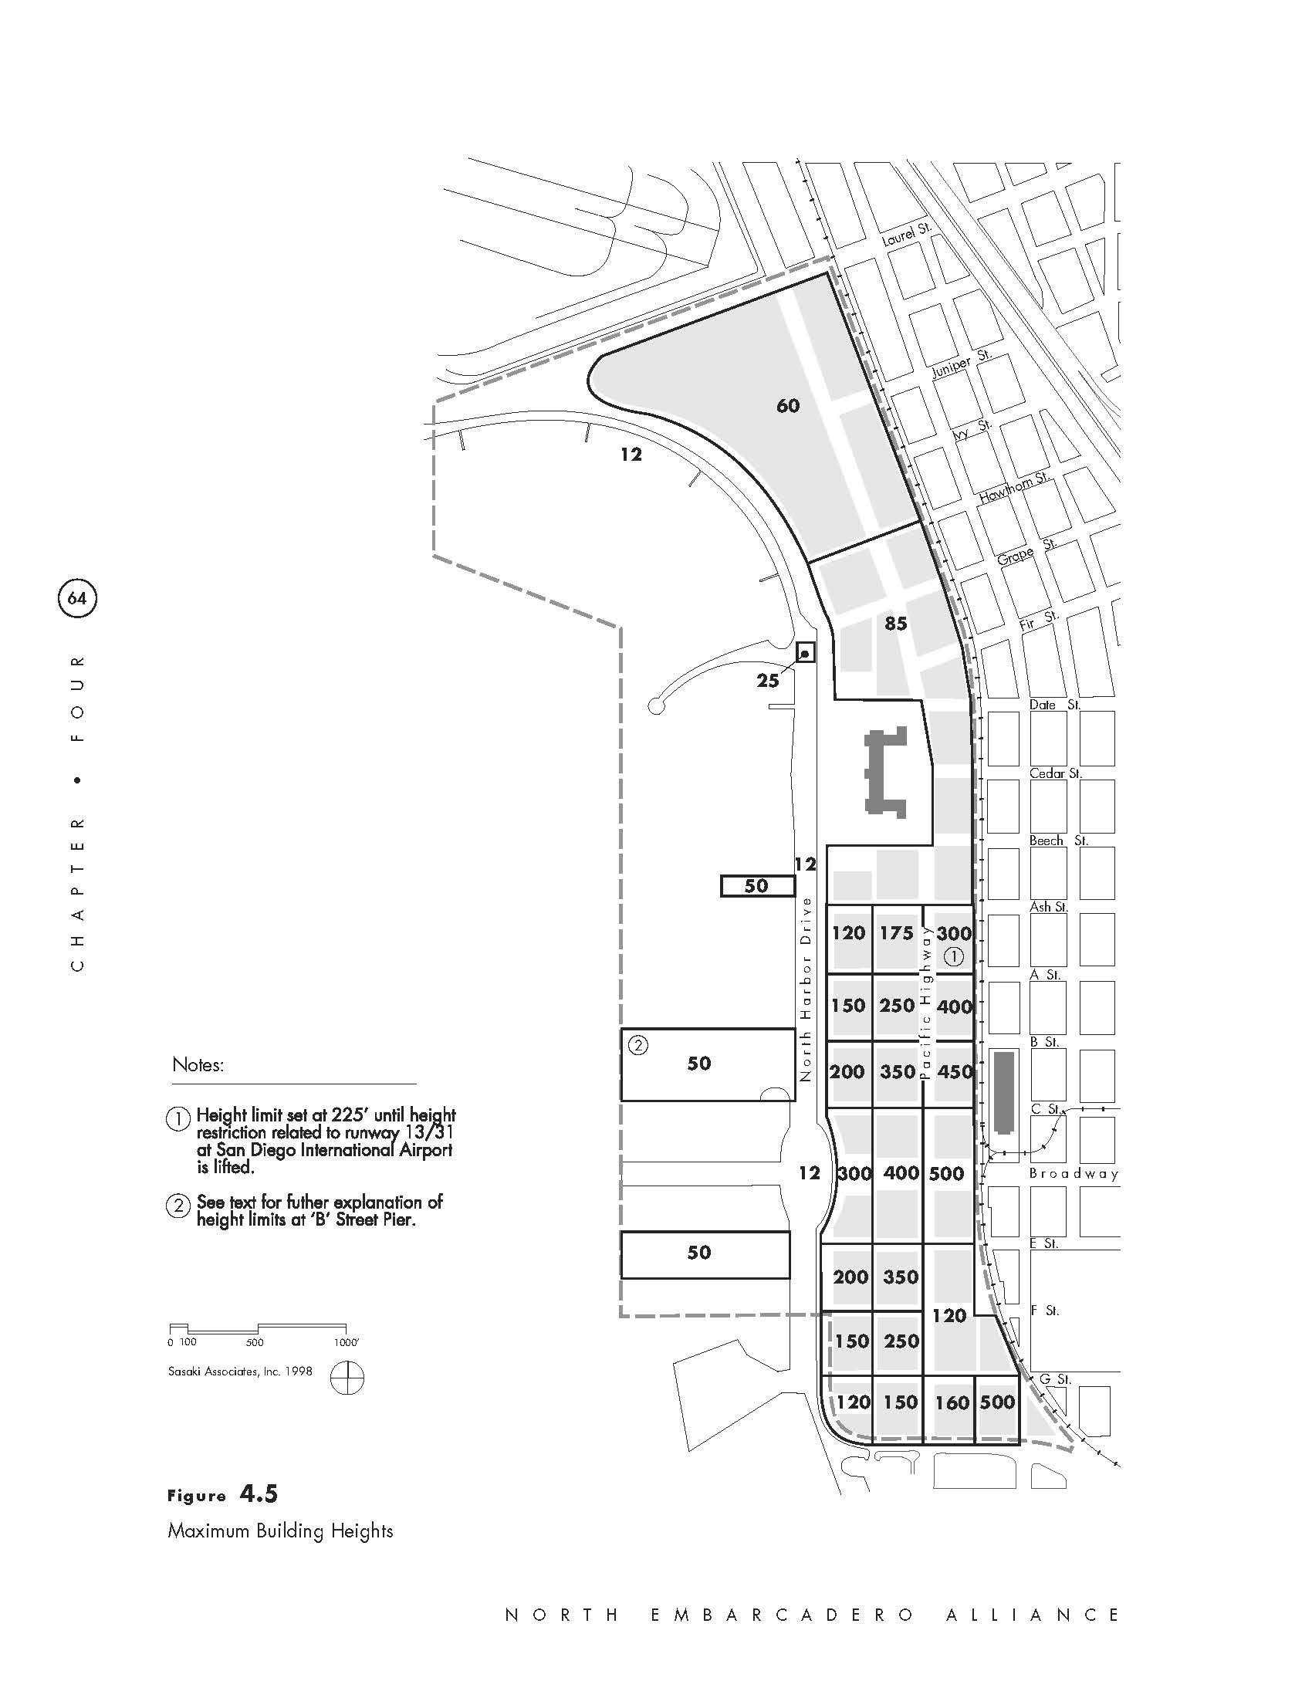
1998 North Embarcadero Alliance Visionary Plan –
Maximum Building Heights
Requested Board Direction
North Embarcadero Subdistrict

Slide 52
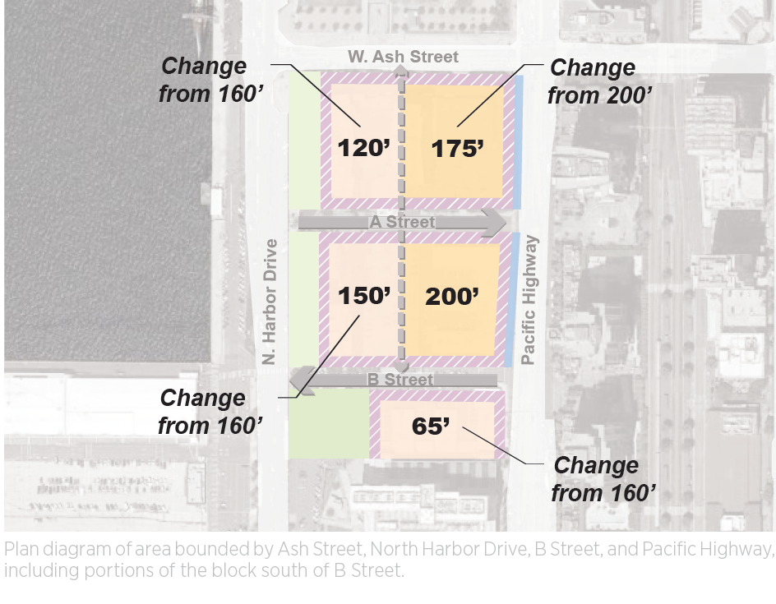
Requested Board Direction
North Embarcadero Subdistrict
Reduction from 160’ to 120’
Reduction from 200’ to 175’
Reduction from 160’ to 150’
Reduction from 160’ to 65’
Proposed Revisions:
Reduce heights to match or be less than 1998 NEVP
Heights to step down to west and north
Increase right-of-way widths for A and B Streets to 80 feet
Coordinate with City staff to match setback and stepback requirements
N
Between Ash Street and South of Proposed B Street Reconnection

Slide 53
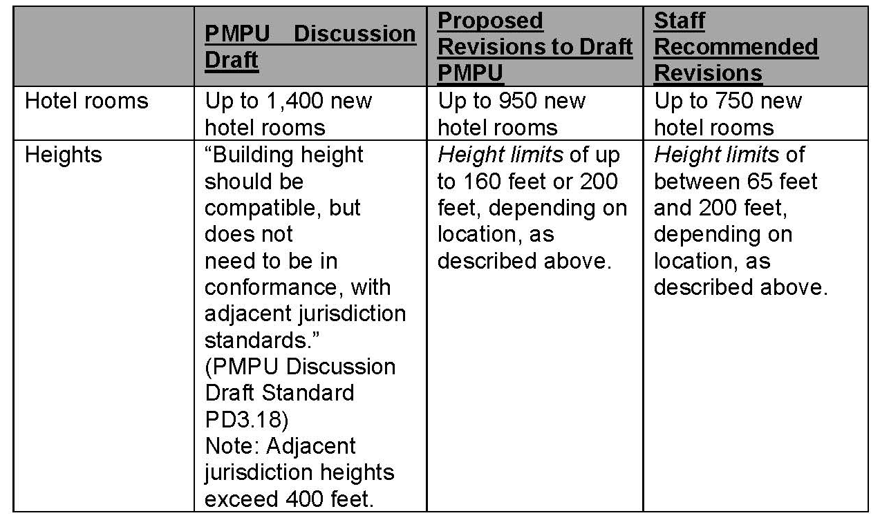
Requested Board Direction
North Embarcadero Subdistrict
Comparison between Proposed
Building Heights and Development Intensities

Slide 54
Requested Board Direction
North Embarcadero Subdistrict
Staff requests Board direction on proposed revisions to building heights and development intensity
Possible options include:
  Keep as proposed in Revised Draft PMPU
  Include staff recommended revisions that reduce heights and development intensity, including additional coordination with City staff
  Provide any other direction the Board deems appropriate

Slide 55
Revised Draft PMPU
Next Steps

Slide 56
Next Steps: Port Master Plan Update Timeline
2017
2018
2019
2020
2021
2022
2023
Jan
Feb
Mar
Apr
May
Jun
Jul
Aug
Sep
Oct
Nov
Dec
Jan
Feb
Mar
Apr
May
Jun
Jul
Aug
Sep
Oct
Nov
Dec
Jan
Feb
Mar
Apr
May
Jun
Jul
Aug
Sep
Oct
Nov
Dec
Jan
Feb
Mar
Apr
May
Jun
Jul
Aug
Sep
Oct
Nov
Dec
Jan
Feb
Mar
Apr
May
Jun
Jul
Aug
Sep
Oct
Nov
Dec
Jan
Feb
Mar
Apr
May
Jun
Jul
Aug
Sep
Oct
Nov
Dec
Jan
Feb
Mar
Apr
May
Jun
Jul
Aug
Sep
Oct
Nov
Dec
Jan
Feb
Mar
Apr
May
Jun
Jul
Aug
Sep
Oct
Nov
Dec
Jan
Feb
Mar
Apr
May
Jun
Jul
Aug
Sep
Oct
Nov
Dec
Jan
Feb
Mar
Apr
May
Jun
Jul
Aug
Sep
Oct
Nov
Dec
Jan
Feb
Mar
Apr
May
Jun
Jul
Aug
Sep
Oct
Nov
Dec
Jan
Feb
Mar
Apr
May
Jun
Jul
Aug
Sep
Oct
Nov
Dec
Jan
Feb
Mar
Apr
May
Jun
Jul
Aug
Sep
Oct
Nov
Dec
Jan
Feb
Mar
Apr
May
Jun
Jul
Aug
Sep
Oct
Nov
Dec
PMPU Drafting Process
CEQA Process / CCC Process
October 20, 2020
4-week Review Period for Revised Draft PMPU
~Summer 2021
Draft PEIR
45-Day Public
Review
~Winter 2021
Final PEIR Certification
& BPC PMPU Approval
PMPU
Disc
Draft
Complete Revisions to Draft PMPU
Complete Preparation of Draft PEIR
Prepare RTC &
Final PEIR
CCC PMPU
Processing
~Winter 2022
Certified PMPU
Drafting Process
August 4, 2020
Board Workshop:
North Embarcadero Subdistrict
October 9, 2020
Board Meeting:
PMPU Status Update
December 7, 2020
Board Workshop:
PMPU Policy Direction
~Spring 2023
BPC PMPU Acceptance
Public Outreach and Stakeholder Engagement
v120320

Slide 57
Revised Draft PMPU
Public Comment

Slide 58
Revised Draft PMPU
Board Discussion & Direction to Staff

Slide 59
Requested Board Direction
New Residential Piers & North Embarcadero Subdistrict
New Residential Piers – Options include:
  Retain proposed Baywide policy and Planning District standards
  Modify Baywide policy and Planning District standards to allow new piers only when public access on shoreline is feasible and connections provided
  Delete Baywide policy and create different standards for each Planning District
North Embarcadero Subdistrict – Options include:
  Keep as proposed in Revised Draft PMPU
  Include staff recommended revisions that reduce heights and development intensity, including additional coordination with City staff
  Provide any other direction the Board deems appropriate

Slide 61
Board of Port Commissioners
Agenda Item No. 1
File No. 2020-0404
PRESENTATION AND DIRECTION TO STAFF ON THE PORT MASTER PLAN UPDATE (PMPU), INCLUDING AN OVERVIEW OF THE COMMENTS RECEIVED ON THE REVISED DRAFT PMPU AND STAFF’S APPROACH TO REVISING THE DOCUMENT
December 7, 2020
PLANNING & GREEN PORT

